Slide 1
Delivering the Yorkshire and Humber Care Record to GP Practices in HCV
Understanding data displayed within the YHCR Interweave Portal
May 2022

Slide 2
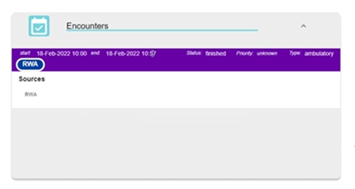

Provider Information on Summary Page
Provider of information is showing the providers ODS code only.
This will be changed in Version 2 of the portal to show provider organisation rather than the ODS code.
Example:
ODS for current Data Providers:
RCB - York Teaching Hospital Foundation Trust
RCD - Harrogate and District Foundation Trust
218 - North Yorkshire County Council
RJL - Northern Lincolnshire and Goole Foundation Trust
RWA - Hull University Teaching Hospital
RV9 - Humber Teaching Foundation Trust

Slide 3
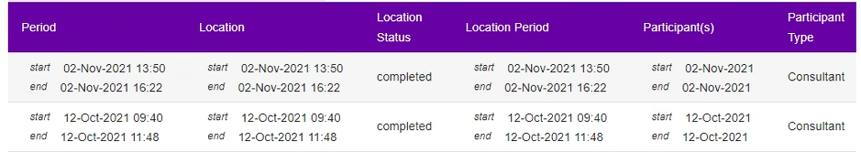
Encounters Panel
The Location field will display a date only if clinic information is not provided
The Participant(s) field will display a date only if Participant(s) name has not been provided
Example:

Slide 4
Episodes of Care Panel
The Episode of Care Type field is showing an abbreviation only.
Work is on-going to align the Type field to display the full name rather than just an abbreviation.
Abbreviation meaning:
RFINPAT - Inpatients
OTPAT - Outpatients
RFAE - Emergency Department
OBSTRETRICS - Obstetrics
RFAHP - Professional Staff Group - AHPs such as physio etc

Slide 5
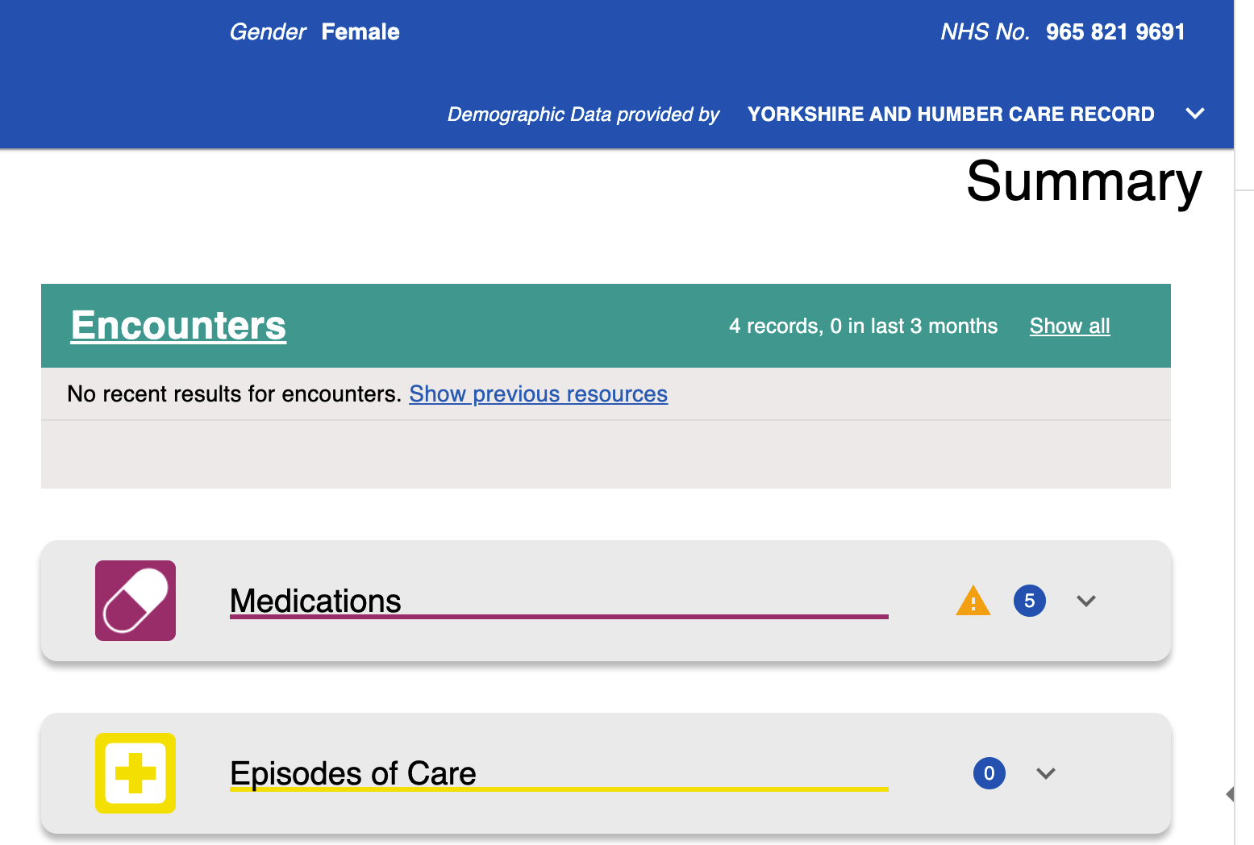
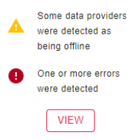
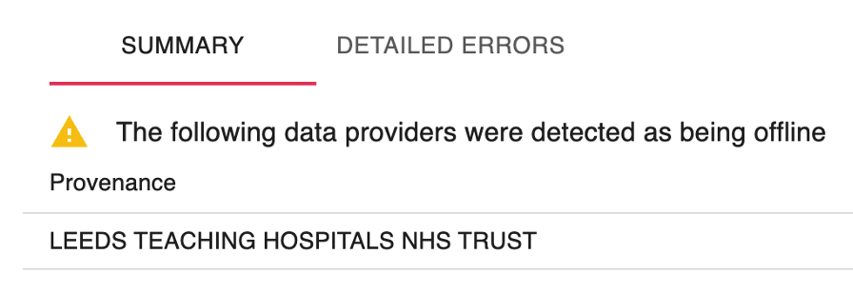
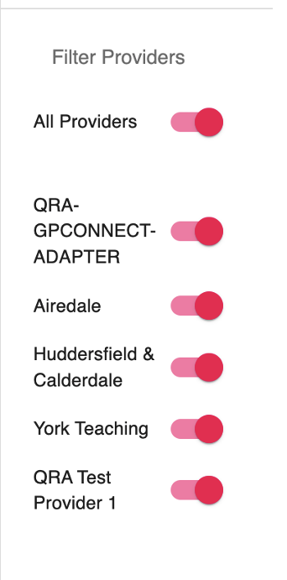
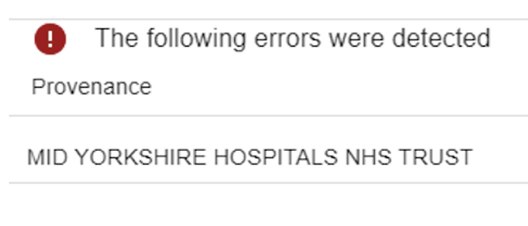
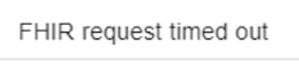
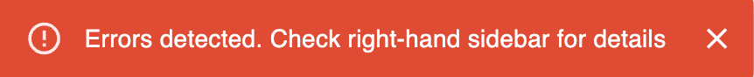
Understanding Errors in the Interweave Portal
Understanding errors
Error messages in the Portal can be related to data being sent to us by health and care organisations.
A red error box (bottom of page) alerts the user to errors.
Errors can be explored using the side bar or from the panels themselves.

Slide 6
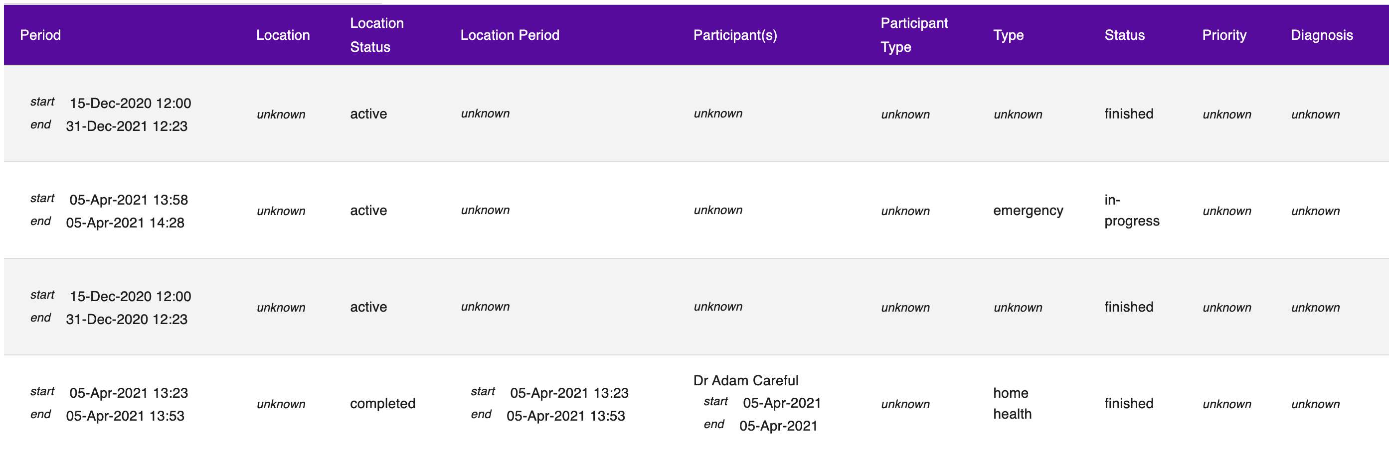
Unknown data
Displaying of unknown data
The use of the term unknown means that the data is not being provided by the organisation.
As we continue to work with providers on their data maturity, we expect this issue to be resolved, however, until then and to avoid any confusion, we are changing Unknown to Not provided.

